Slide 1



Neural Information Retrieval
In search of meaningful progress
Bhaskar Mitra
Principal Applied Scientist
Microsoft
@UnderdogGeek
bmitra@microsoft.com

Slide 2















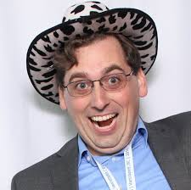






Shout out to all my mentors/collaborators/co-authors over the years!
…and many others

Slide 3

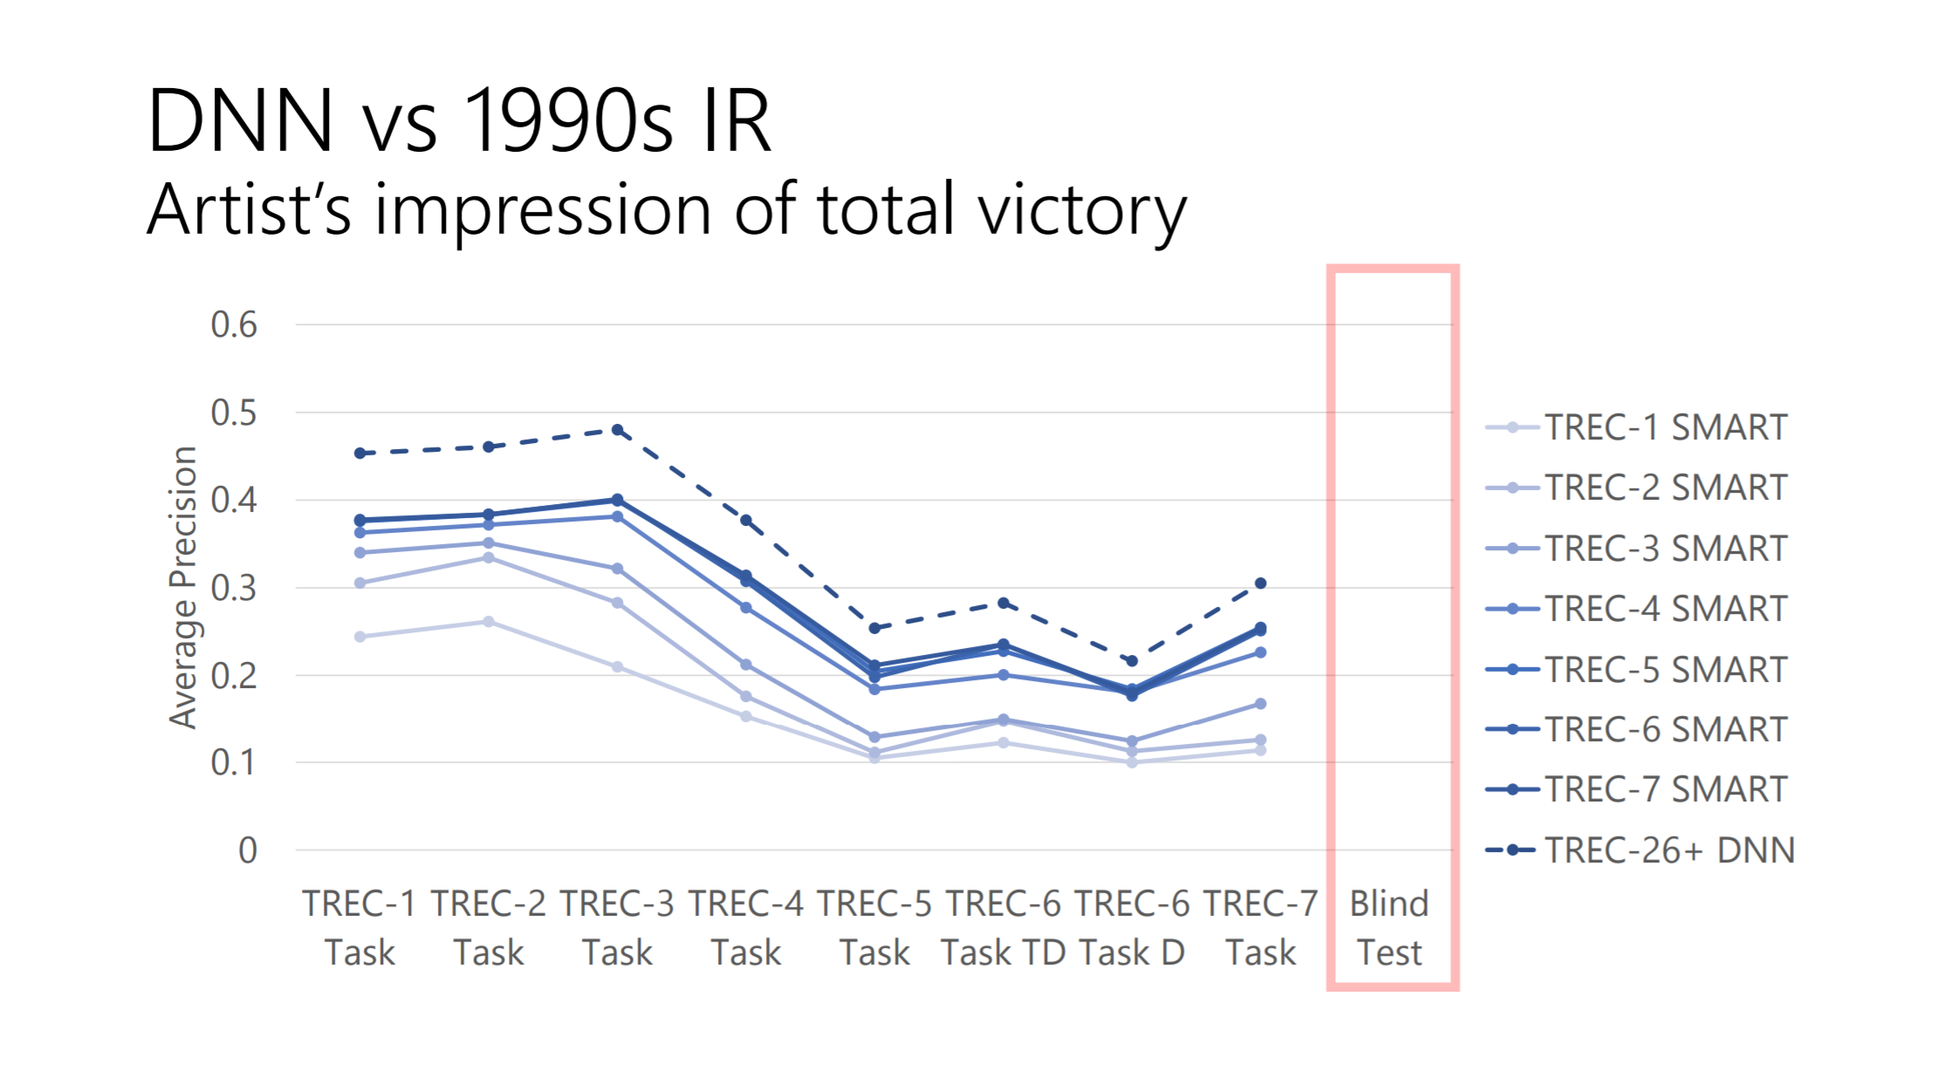
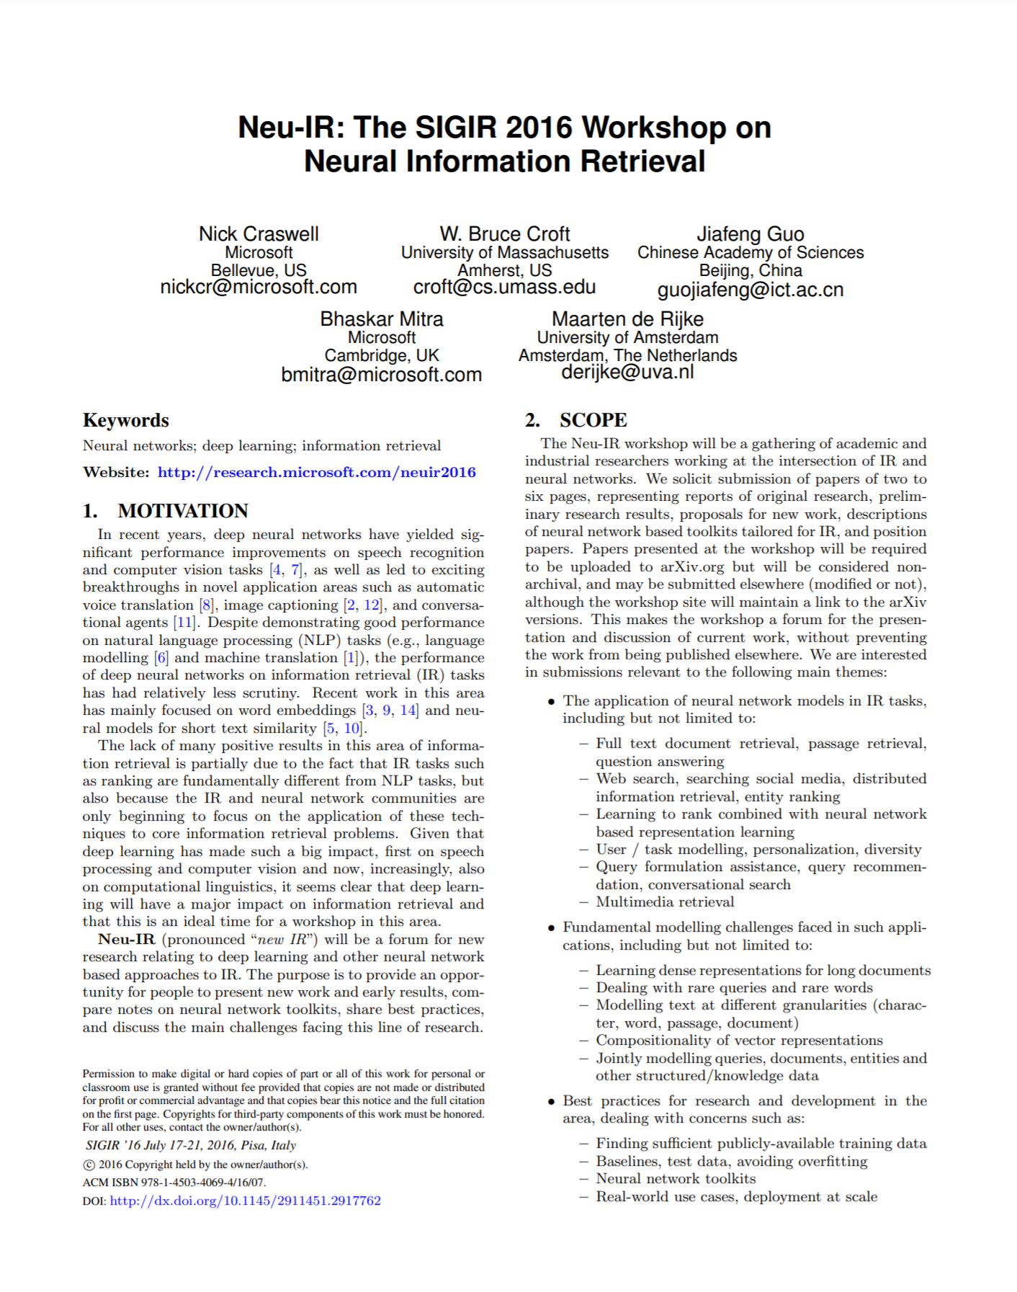
Early days of neural IR

Slide 4
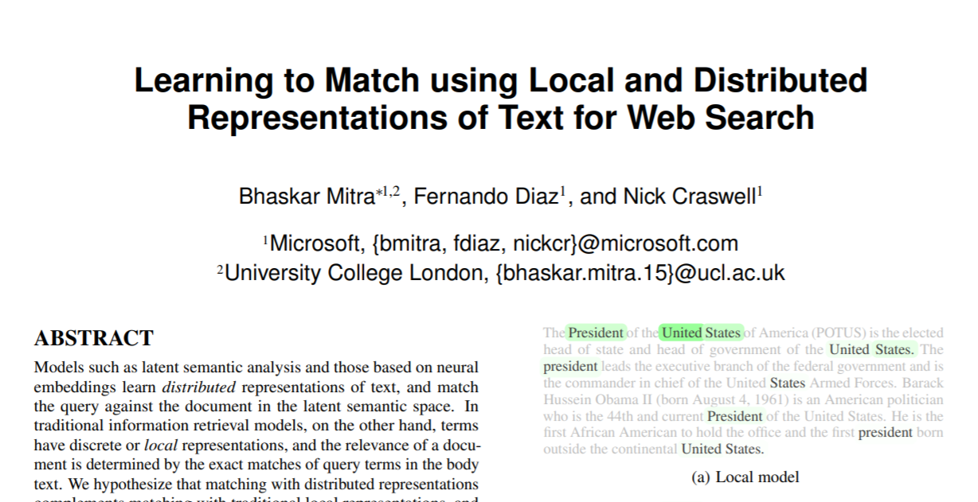
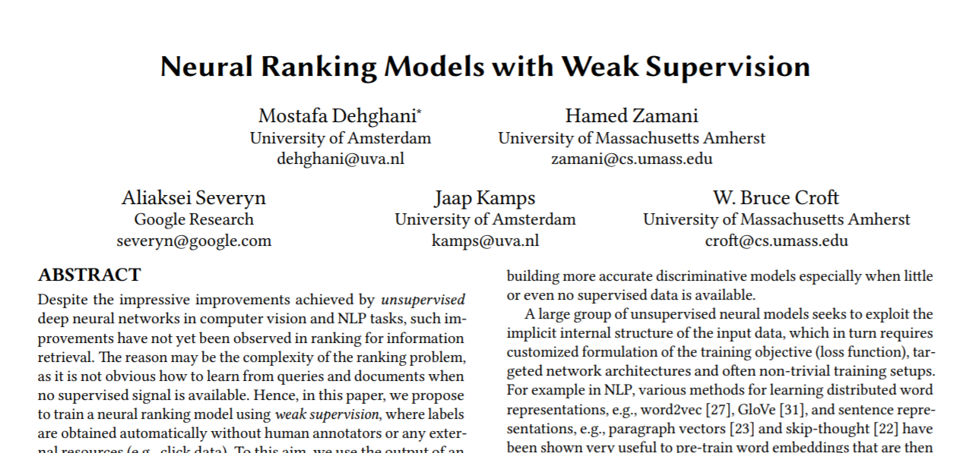
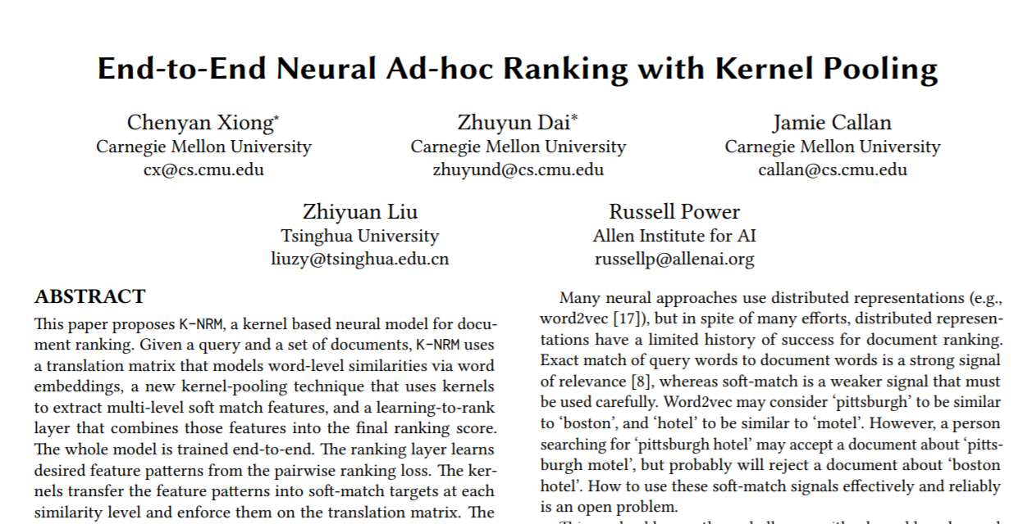
First wave of deep document ranking models
Duet
Weak supervision
Trained on 200K English queries from Bing.com (proprietary dataset)
KNRM
Trained using BM25-based weak labels
Trained on 95K Chinese queries from Sogou.com (public dataset)

Slide 5

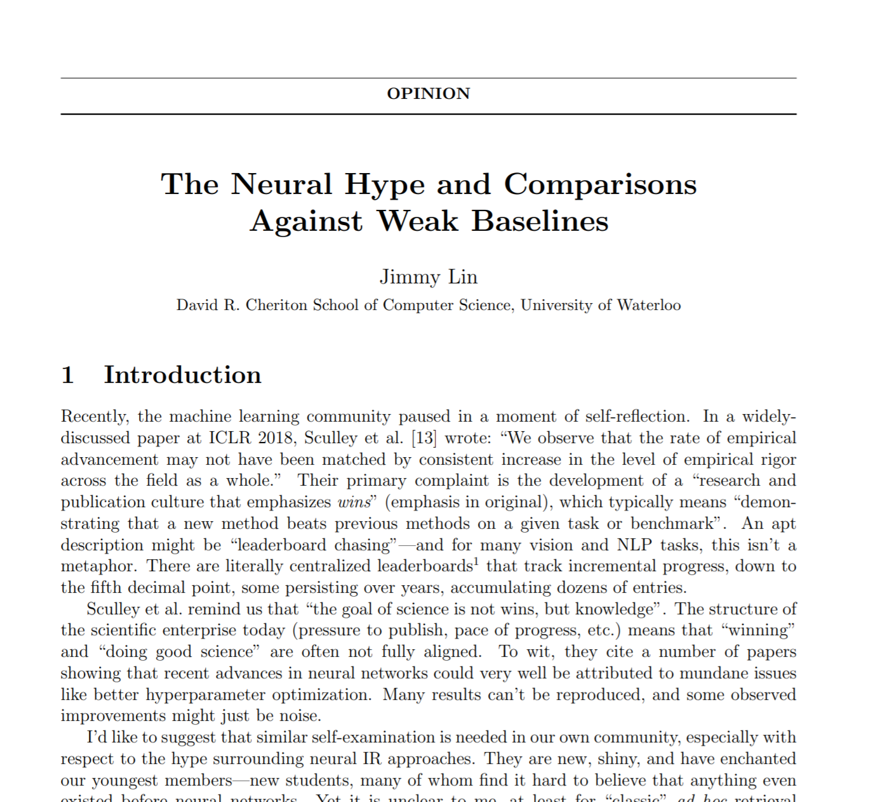

But are we making real progress?
2018
¯\_(ツ)_/¯
MS MARCO passage ranking benchmark launches with 0.5M+ English training queries
The myth of “no neural IR model worked before BERT”: first generation deep ranking models, e.g., Duet and KNRM, and their variants, outperform most traditional IR methods by reasonable margin on the MS MARCO benchmark
Passage Ranking Leaderboard

Slide 6
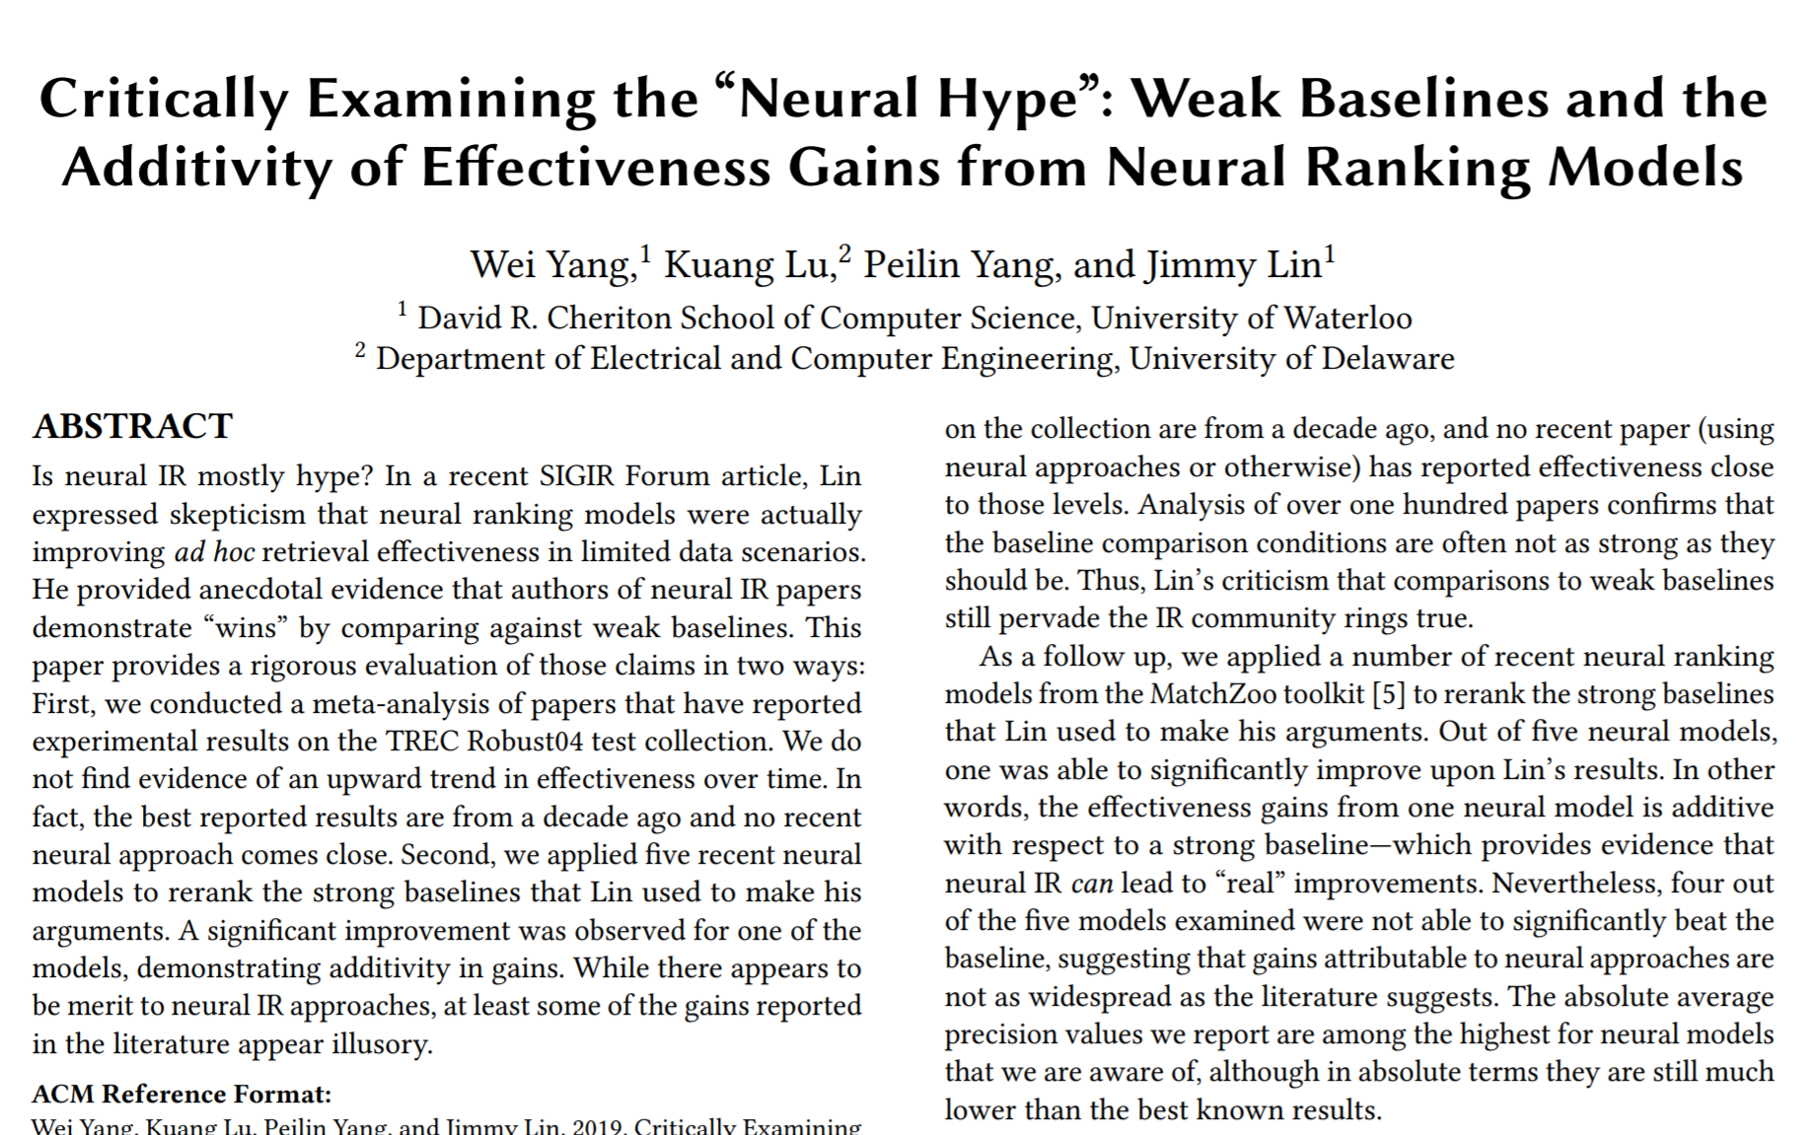
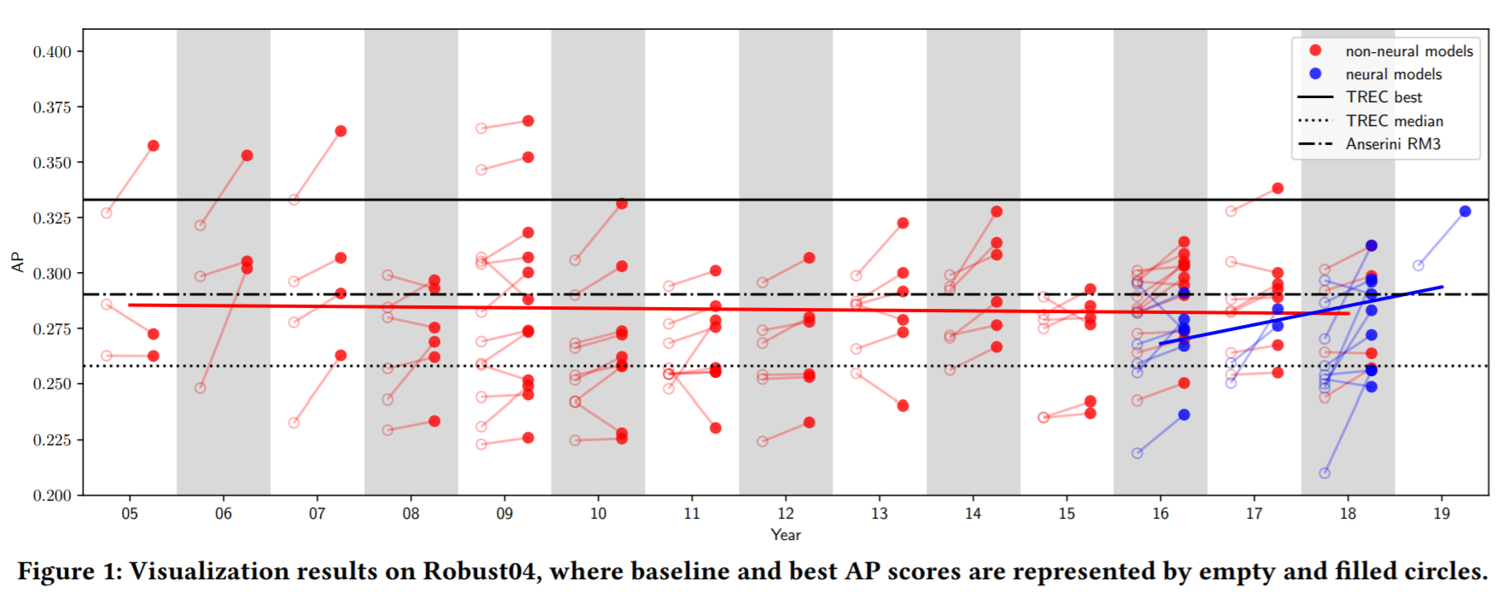
Did neural IR really have a “weak baselines” problem?
I will argue NO: (i) pre-MS MARCO, most neural IR papers benchmarking on Robust04 were NOT trained on large labeled datasets and represent a biased sample of neural IR papers, and (ii) even in those cases there is little evidence that these papers employed any weaker baselines than non-neural IR papers
Why is this important?
1. Can’t expect every paper to beat SOTA. Focus is often on hypothesis testing. Check for appropriate baselines, not SOTA baselines. Improvements over emerging methods (not yet SOTA) should be encouraged.
2. Early generation deep ranking models provided many useful insights and created the demand for large training dataset. 👏🏽

Slide 7
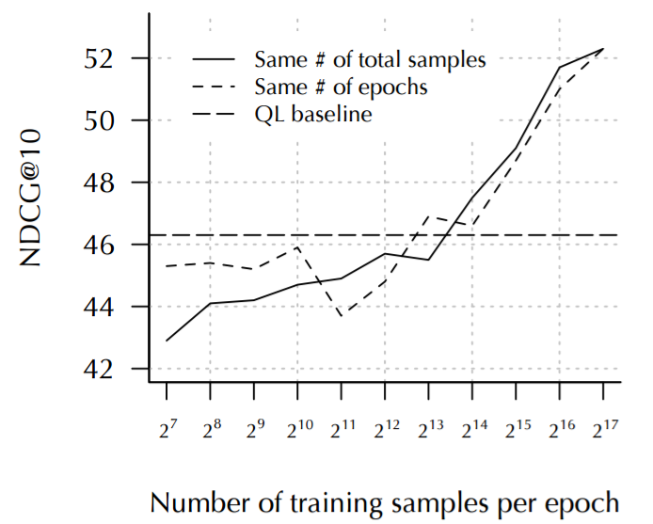

But we had a BIGGER benchmarking problem
The lack of public IR benchmarks with large scale training data led to:
Comparisons under low-data regime
e.g., older TREC collections with few hundred queries
Comparisons on (semi-)synthetic benchmarks
e.g., TREC CAR
Comparisons under weak supervision training
Comparisons on corpus of language different than what the models were designed for
Performance of deep models typically improve with more training data
(image source: The Duet paper)
Non-standardized benchmarks also required reimplementation of baselines (specially, neural baselines) which in turn meant that many of them were under-tuned, in turn, contributing to the “weak baselines” problem!

Slide 8

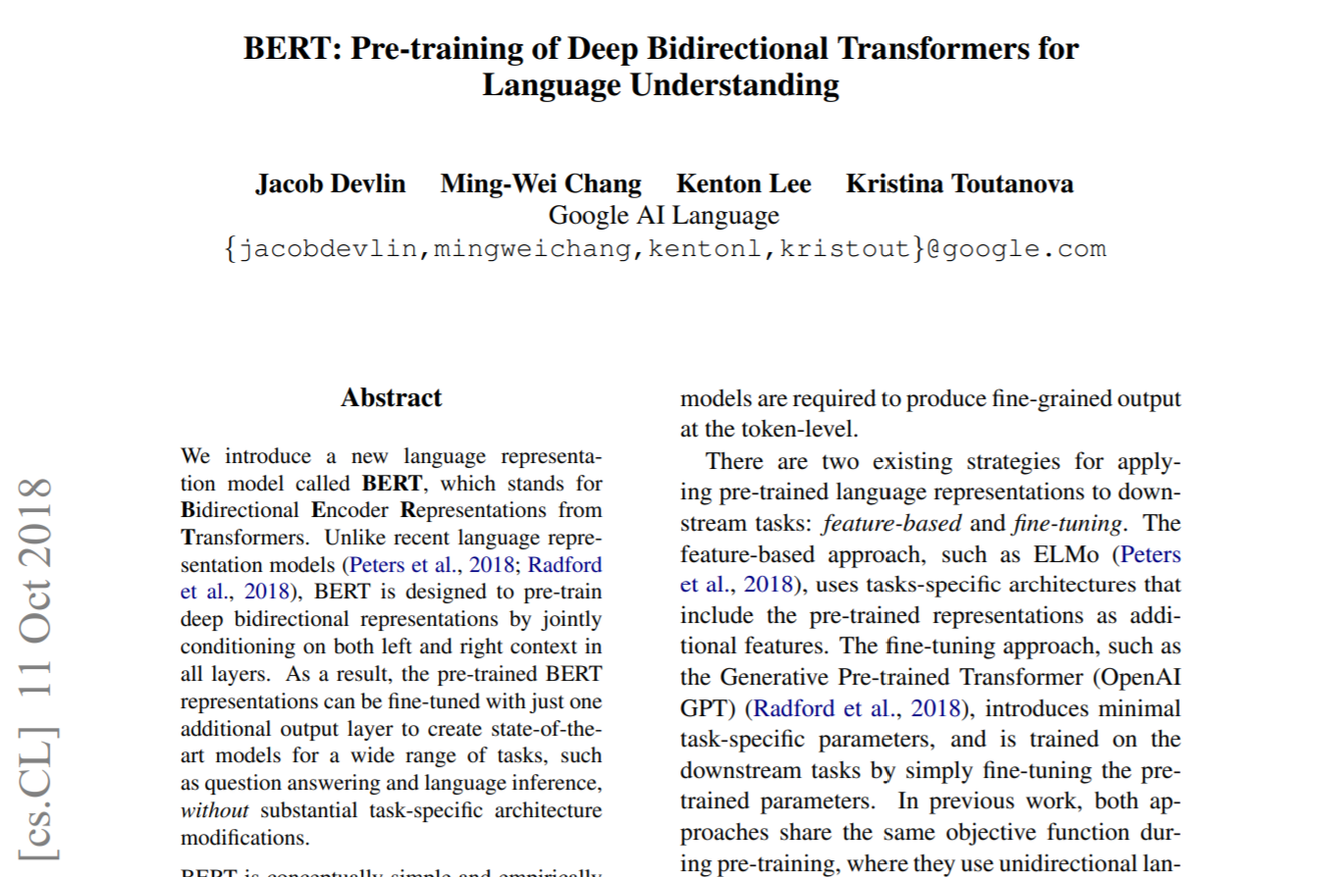
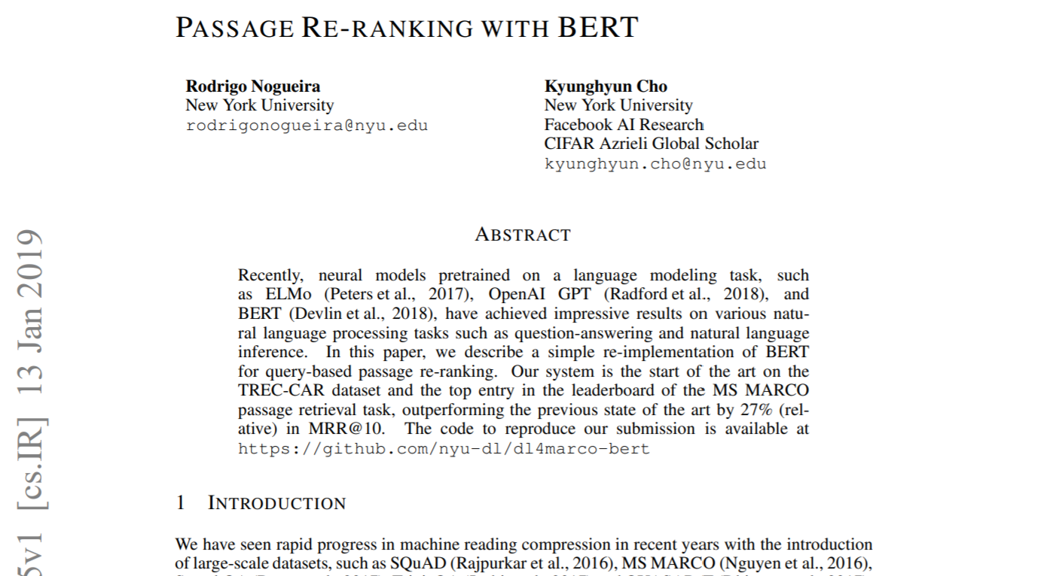

The year of BERT
2019
Less than 3 months after the BERT paper hits arXiv the first BERT-based reranking model achieves 0.359 MRR compared to previous state-of-the-art of 0.281 on MS MARCO

Slide 9
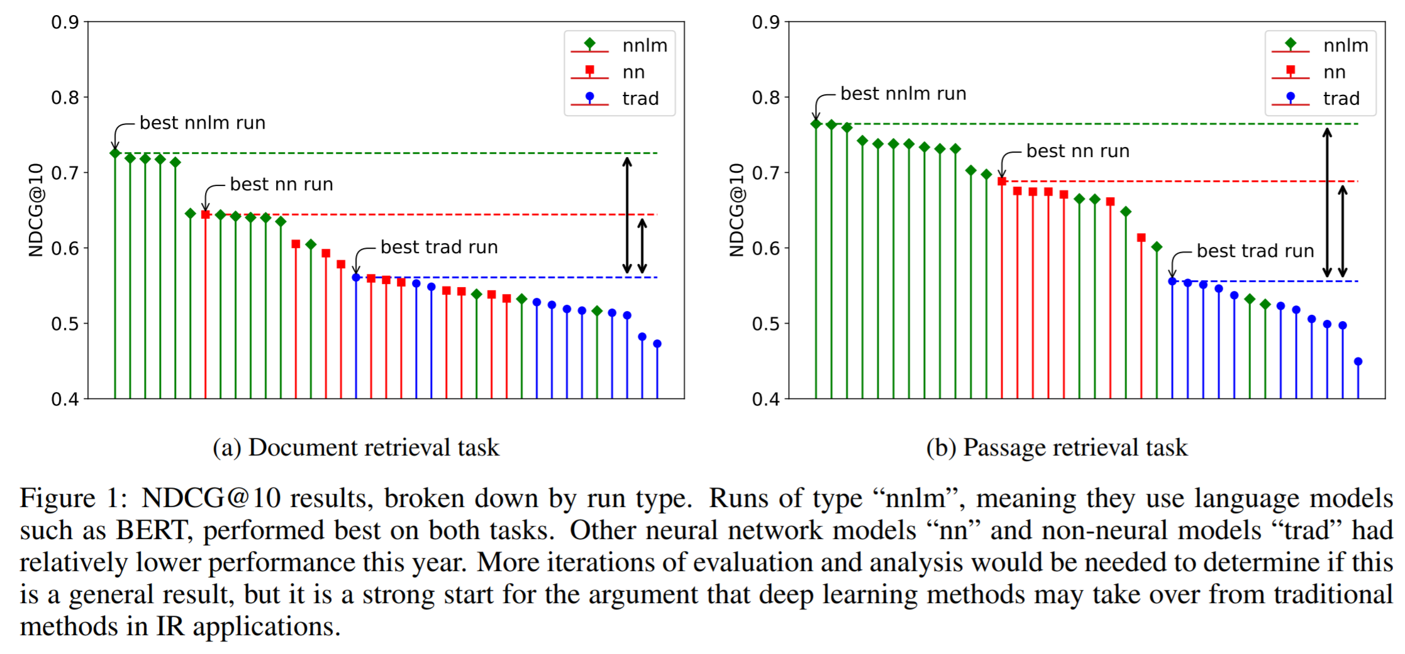

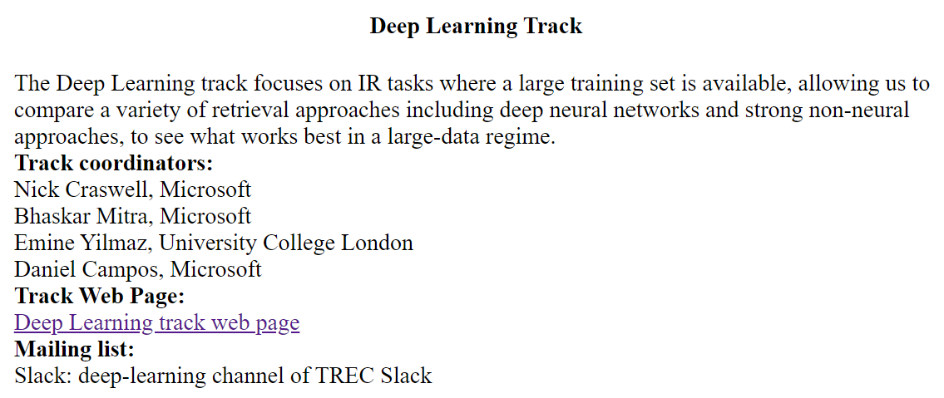
TREC Deep Learning Track (2019)

Slide 10
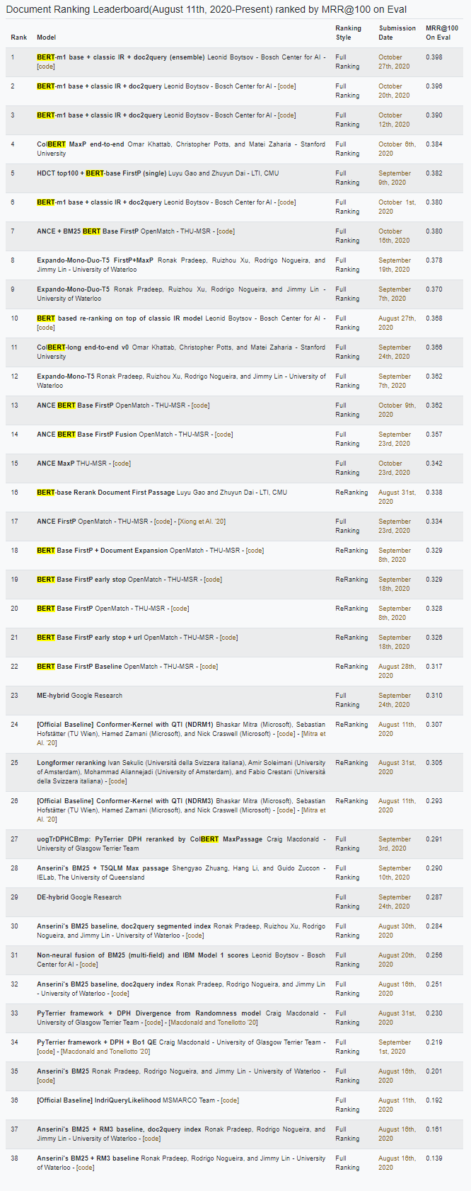
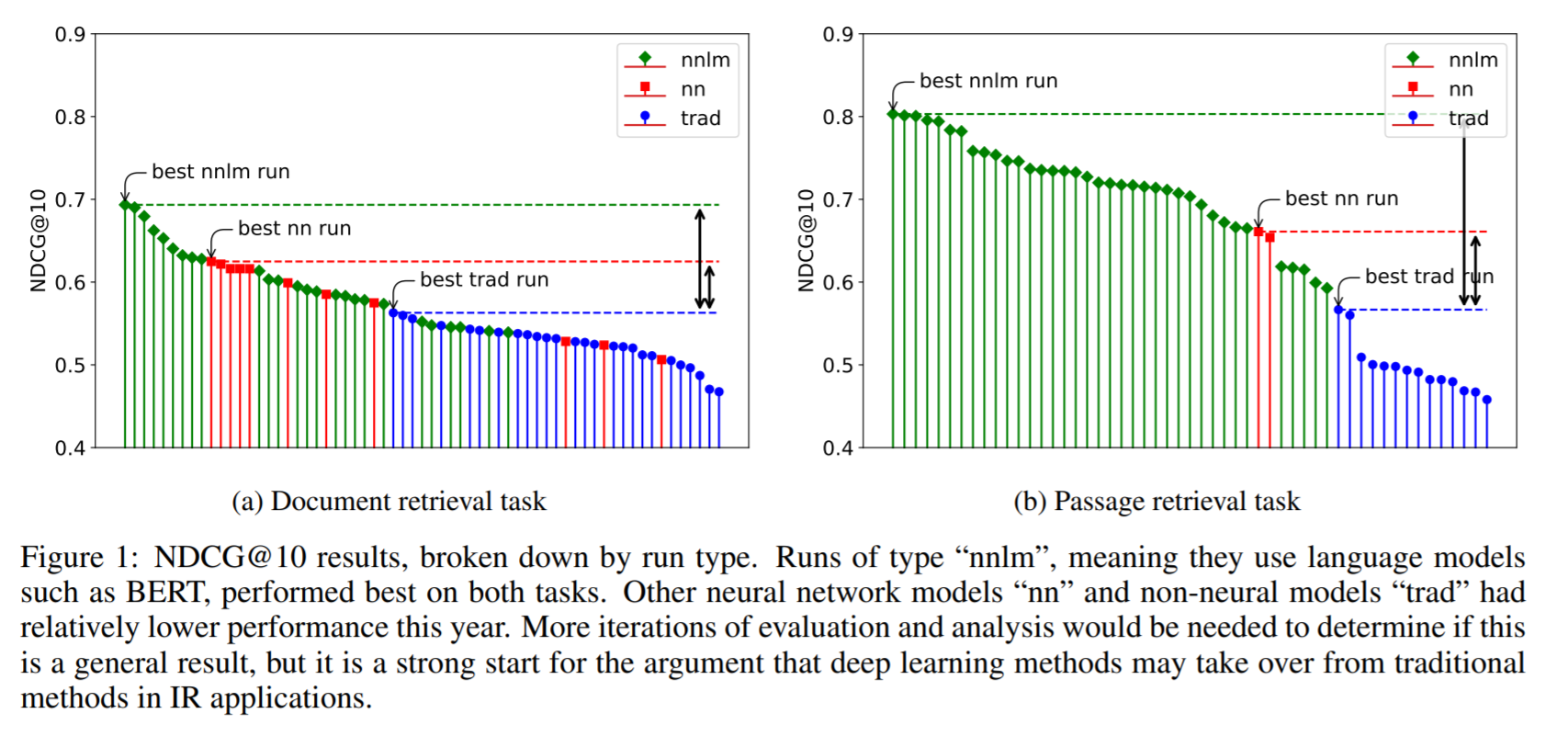

2020
Document Ranking Leaderboard
+
TREC 2020 Deep Learning Track
Also, this guy
😒👇

Slide 11
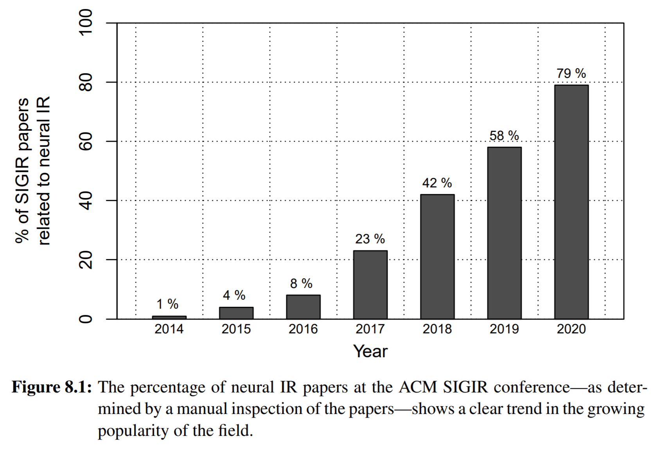
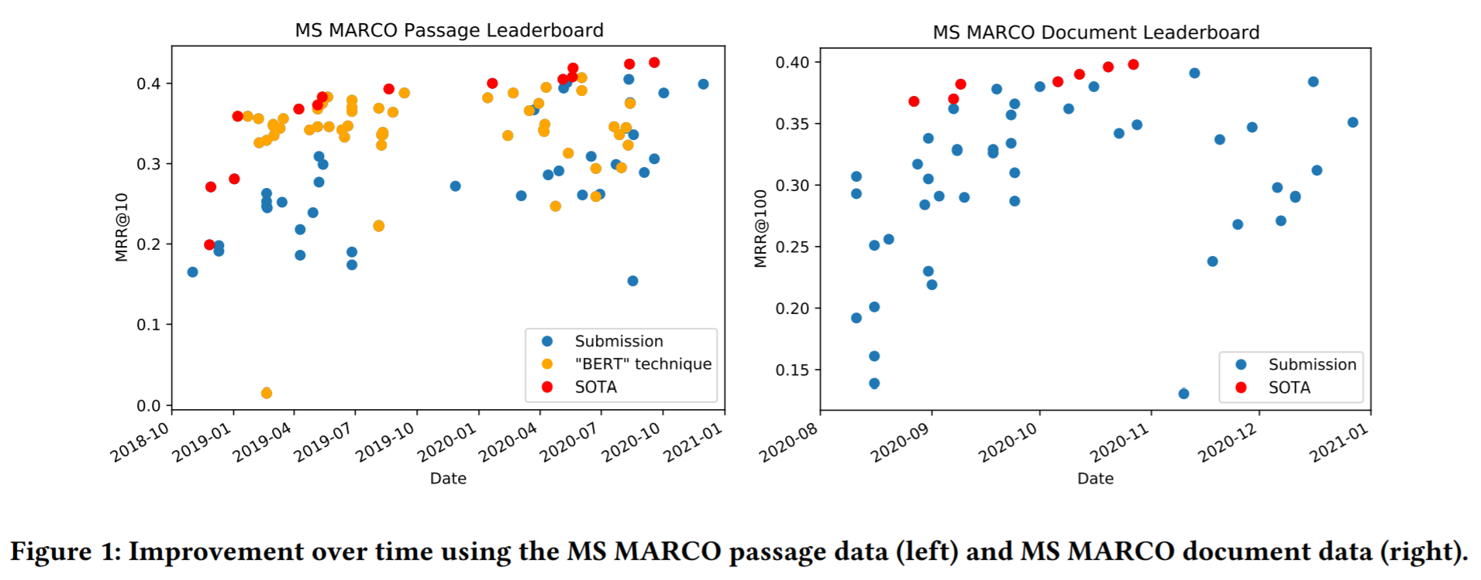
Are we making progress?
Deep learning models have gone from novelty to commodity in communities like SIGIR—parallels to how learning-to-rank models “took over” IR
Deep models have demonstrated large gains over previous state-of-the-art, and the gap continues to grow
But we must be careful of how we interpret “progress”, and interrogate the evidence when it is largely based on a single benchmark

Slide 12
Are we making meaningful progress?
Internal validity
Overfitting via multiple testing
validity of leaderboard ranking
External validity
Overfitting to single task or data distribution
Statistical validity
IR metrics and interval-scale
Externalities
No data ≠ no progress
Social harms and ecological costs

Slide 13
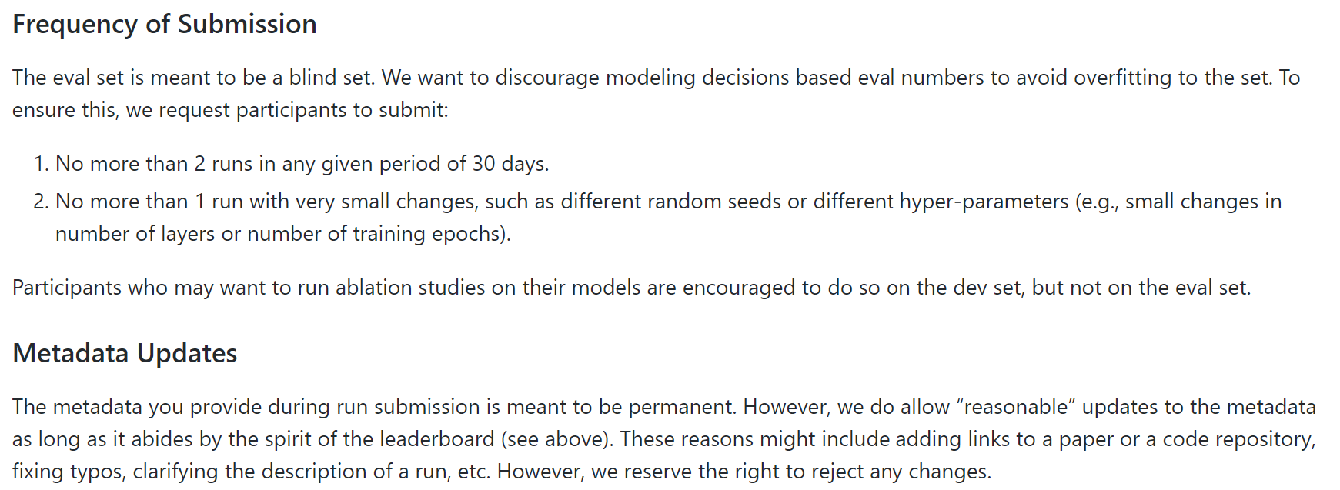
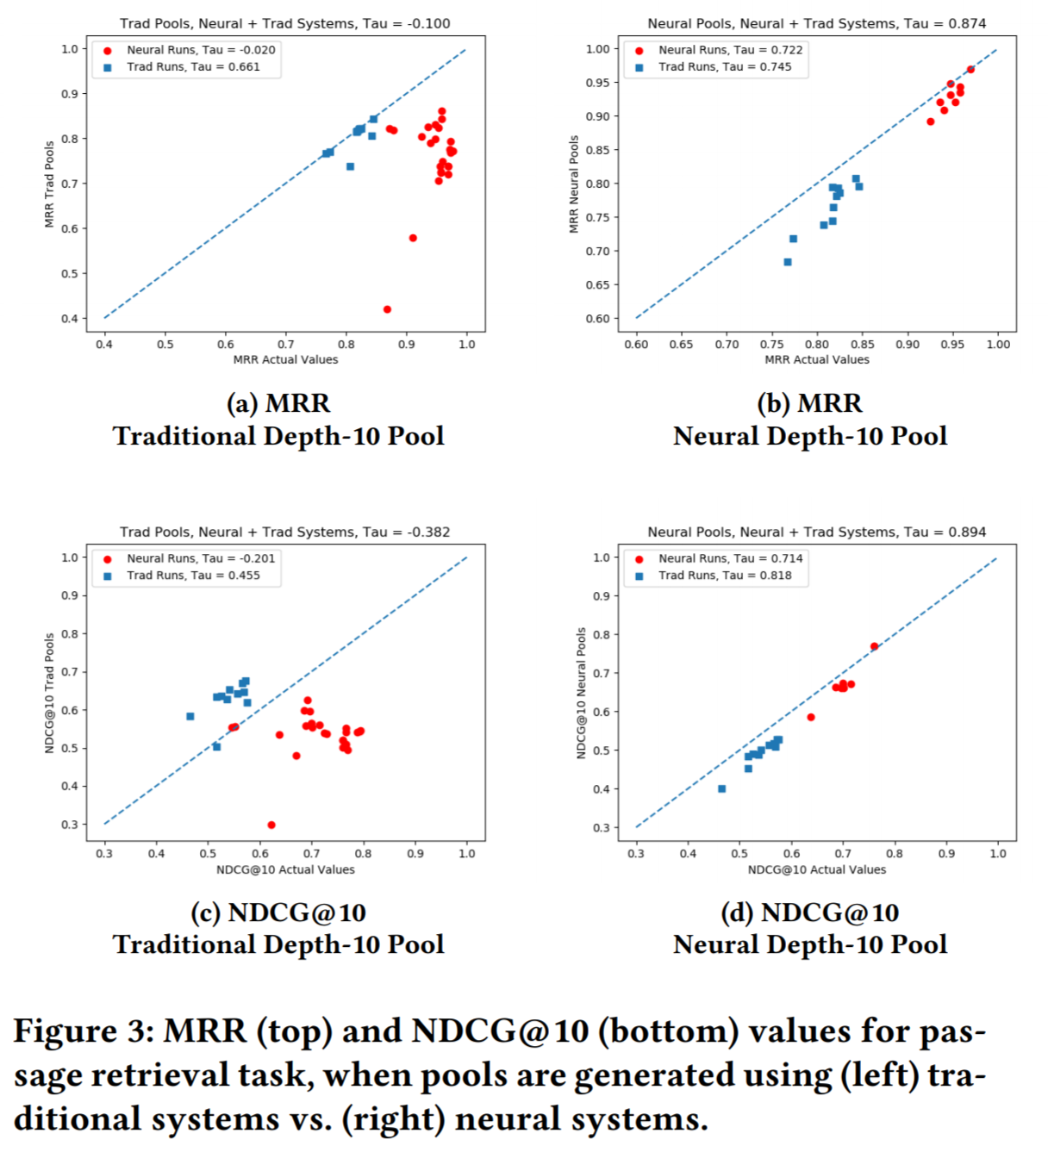
Internal validity
Best practice for avoiding multiple testing → Participate at TREC (single-shot submission + pooled judgments)
MS MARCO Leaderboard allows multiple submissions, but we discourage frequent submissions and metadata updates
Least robust: Reuse TREC test set from previous year for evaluation—but useful if we follow strict experiment protocols

Slide 14
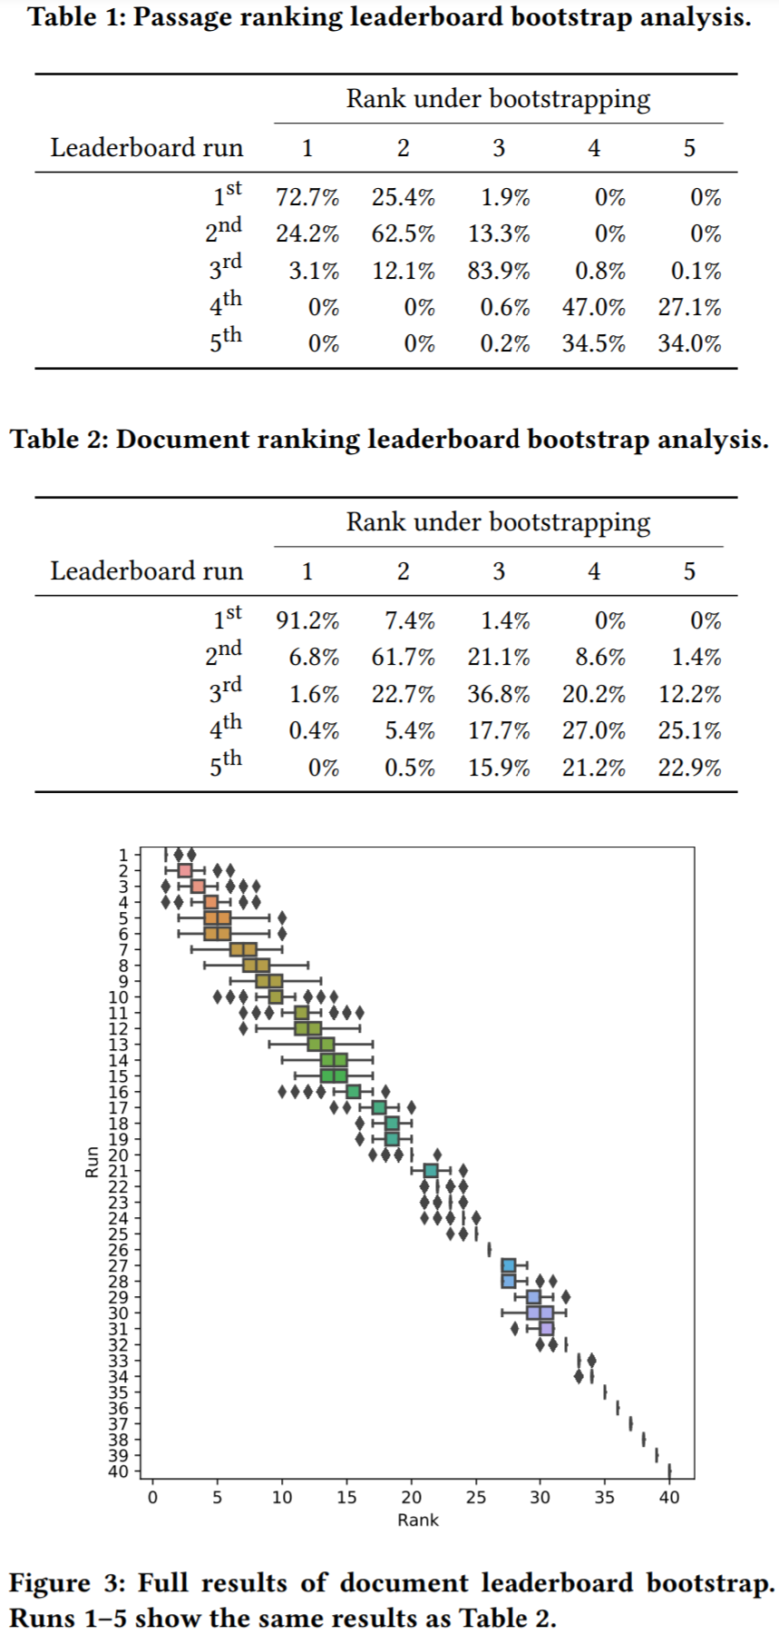
Stability of MS MARCO public leaderboard
Under bootstrap analysis we find the leaderboard rankings fairly stable!
Very unlikely that a lower-ranked run would overtake a top-ranked run under bootstrapping 😊👍

Slide 15
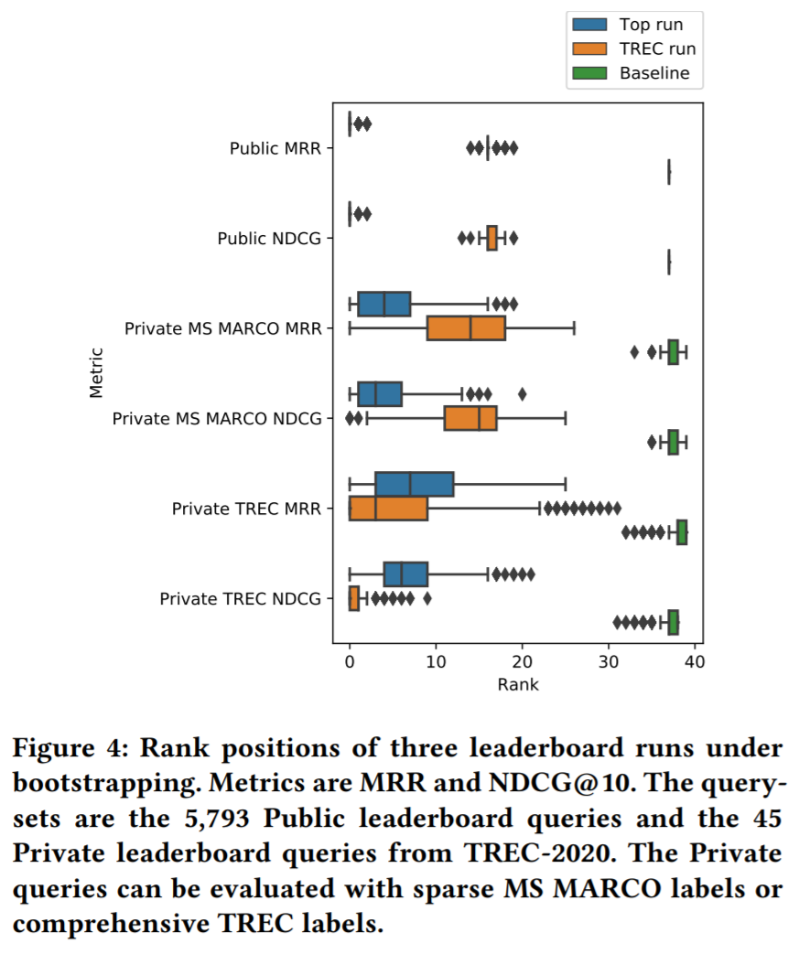
Private leaderboard
We included 45 TREC 2020 queries in the document ranking eval set
The top leaderboard run has a more “spread out” rank on the TREC queries and is overtaken by the best TREC 2020
This may be due to distribution difference between the two test sets or the smaller size of the TREC set

Slide 16

External validity
If MS MARCO’s training data were to be only useful for achieving good results on MS MARCO’s test set, then it’s less useful for the IR community
Important: transfer learning from MS MARCO to other benchmarks
TREC DL is transfer learning (MS MARCO sparse binary labels → NIST’s 5-point labels)
Promising results: MS MARCO → Robust04, TREC-COVID, TREC-CAsT
Med-MARCO (medical subset of MS MARCO)

Slide 17
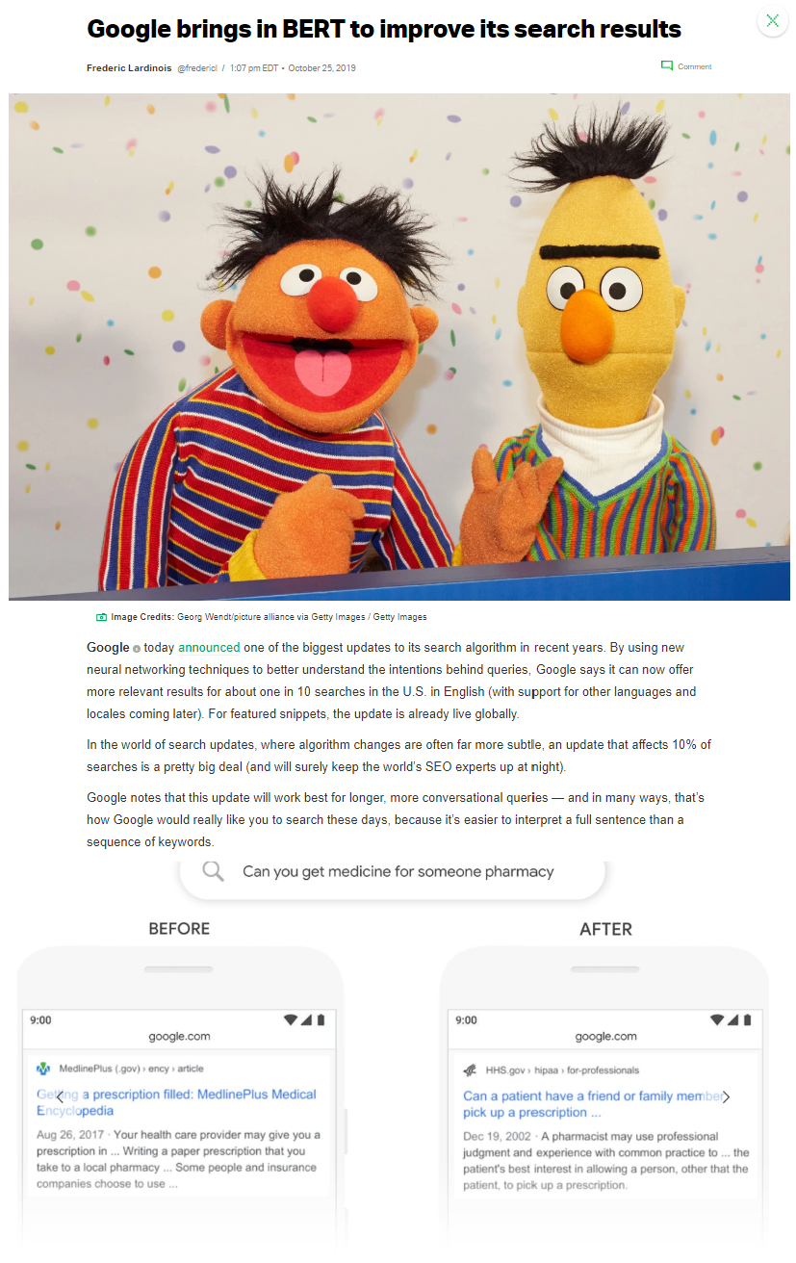
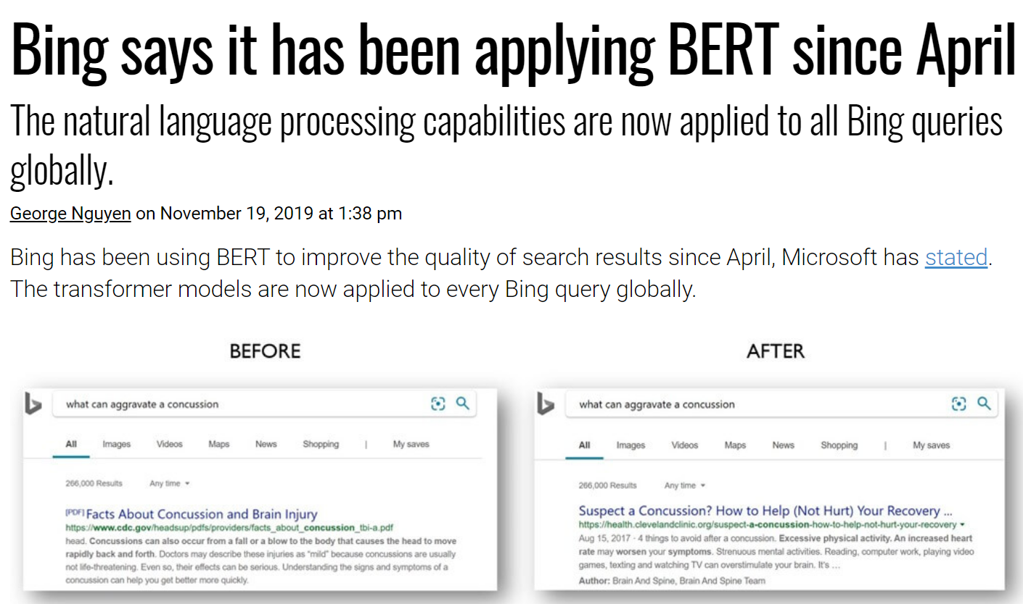
Industry impact
BERT-scale deep ranking models in production search systems

Slide 18
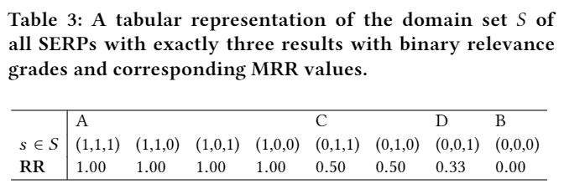
Statistical validity
Recent debate by Ferrante et al. on whether IR metrics like RR and NDCG are interval-scale
Their argument based on representational theory of measurement: we must satisfy the solvability condition over the empirical set of all possible SERP states
In this example involving the domain set of all SERPs of length 3 and binary notion of relevance, this requires the existence of some SERP corresponding to RR of 0.17 and 0.83

Slide 19
Our position on the interval-scale debate
IR metrics are fundamentally not measurements over SERP states, but over all possible user-perceived relevance/utility states
It may not be important that we cannot realize a RR value of 0.17 if we believe there exists some user-perceived relevance state that corresponds to that value of the metric
Of course, there’s no reason to believe these metrics are interval-scale even with respect to user-perceived relevance/utility states
How to correctly calibrate these metrics is an interesting area for future research

Slide 20
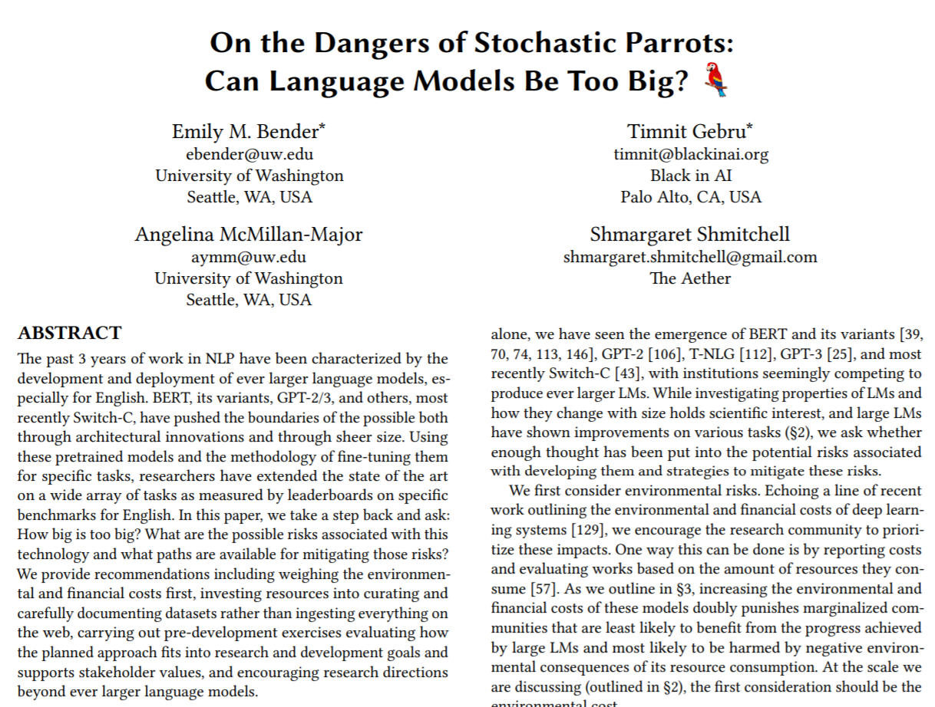

Externalities
When we create benchmarks, we implicitly tell the community where to focus their research
Scenarios without data (e.g., non-English IR) can suffer consequently
We must also consider the social and ecological costs of the models that we are encouraging to be developed

Slide 21
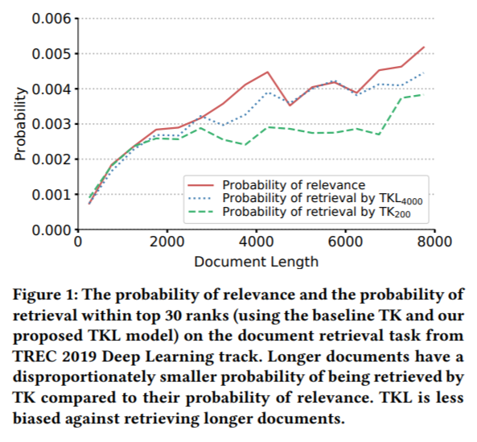
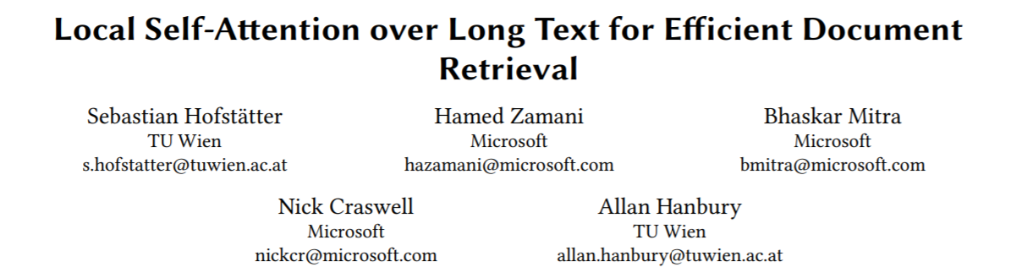

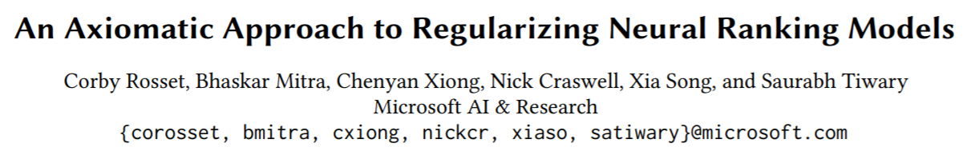
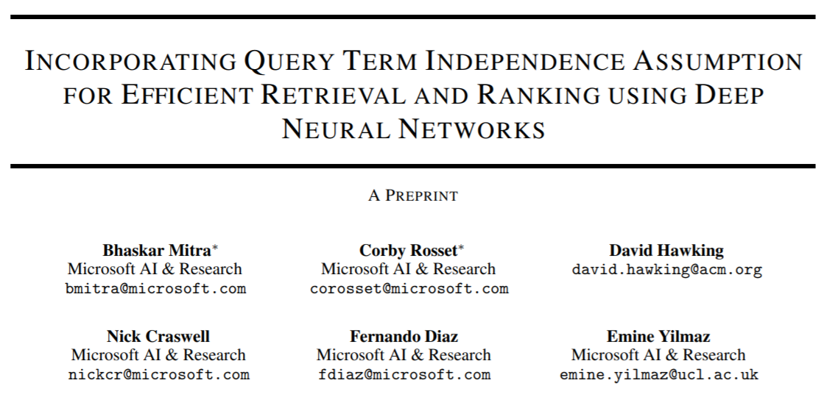

The “IR” in Neural IR
(revisiting probability of relevance and retrieval for different document lengths)
Are we making meaningful connections between decades of research on traditional IR models and recent deep models?
Are we incorporating insights from traditional IR into deep model design?
Are deep ranking models teaching us something fundamental about IR?
Compared to the first wave of deep models, recent BERT-style models are:
Harder to interpret
Not obvious what they encode
Not obvious what we learn about IR
(IR axioms to guide and diagnose deep neural models)
(Incorporating properties of traditional IR approaches into deep models)

Slide 22
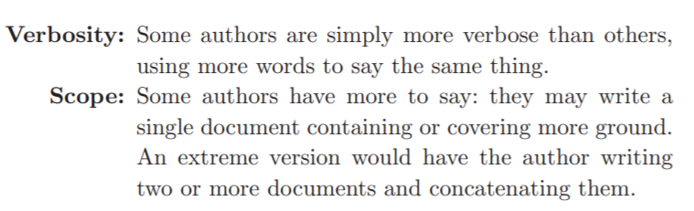
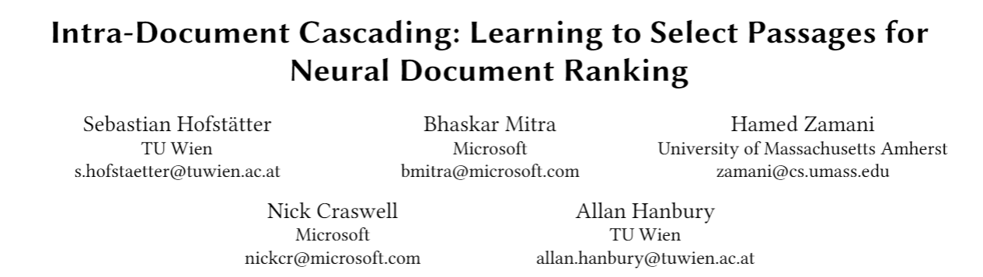
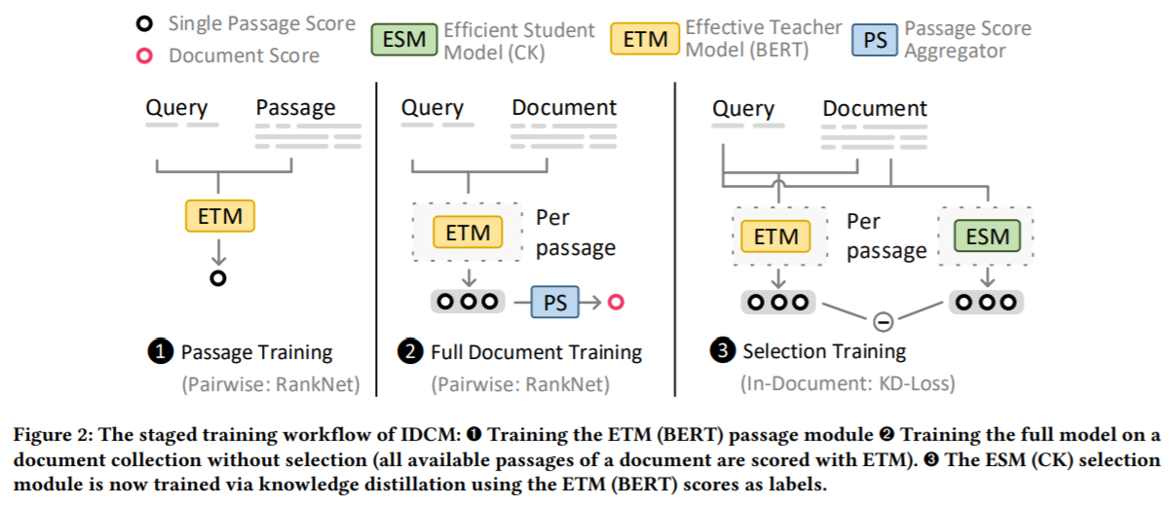
Revisiting old debates: verbosity vs. scope hypotheses
A typical recipe for using BERT-style models for document ranking is to compare the query independently with individual body chunks and then aggregate signals
These neural architectures are more in line with the scope hypothesis—what does their efficacy say about how we should think about long documents?

Slide 23

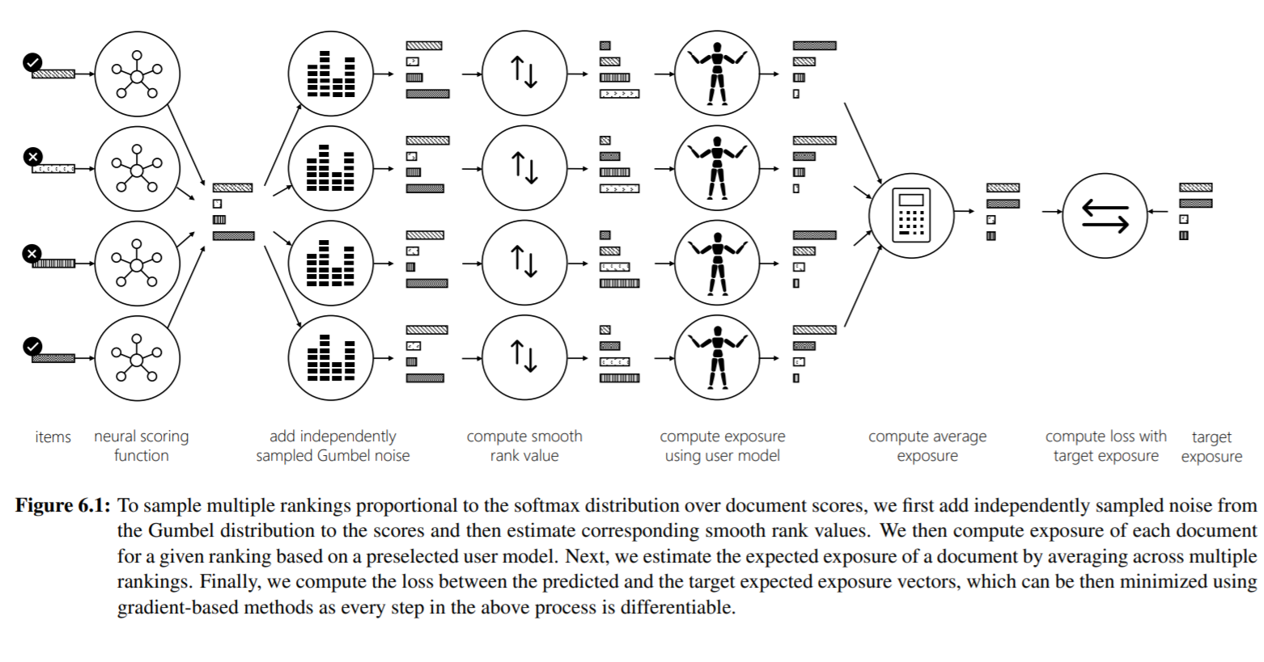
New opportunities: Optimizing for new IR measures
Deep models with gradient-based optimization may allow deep models for new IR tasks and metrics
E.g., stochastic ranking and optimizing for exposure-based metrics
May be important in the context of fairness, diversity, and monetization

Slide 24
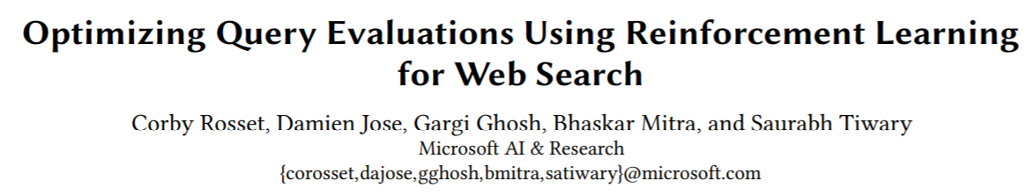
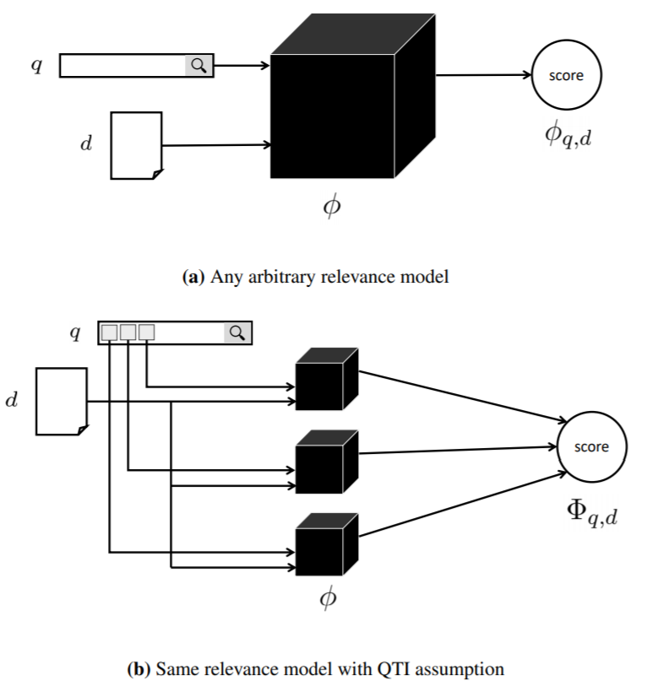
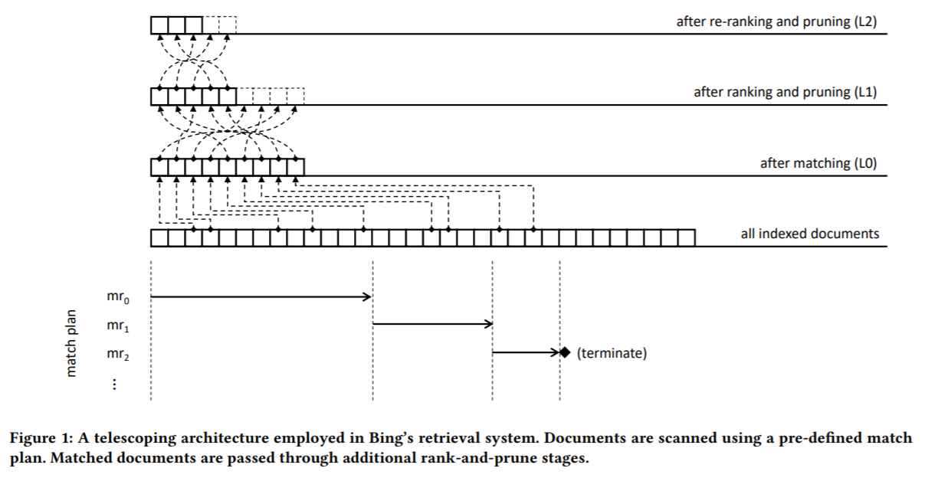
New opportunities: data structure aware ML models

Slide 25
Thinking of neural IR more holistically
Rapid exploration of ML models that can achieve large improvements on standard IR tasks. But it’s not all about leaderboard chasing.
Thoughtful exploration of how IR and deep learning interacts. what can deep learning teach IR? What can IR teach deep learning?
Critical conversations about the impact of the technology we build. Centering on social and ecological impact. Being intentional about where the field is going.
Careful curation of benchmarks and other artifacts to support the research community. Making it easy to build on each other’s work. Bridging the industry-academia divide.

Slide 26
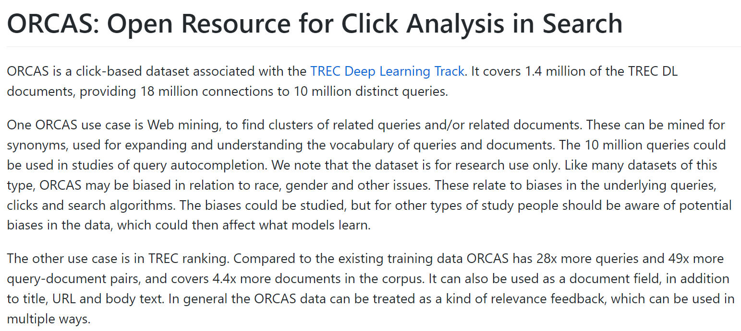
Reusable research artifacts: Data
https://microsoft.github.io/msmarco/TREC-Deep-Learning
http://msmarco.org/
https://microsoft.github.io/msmarco/ORCAS

Slide 27
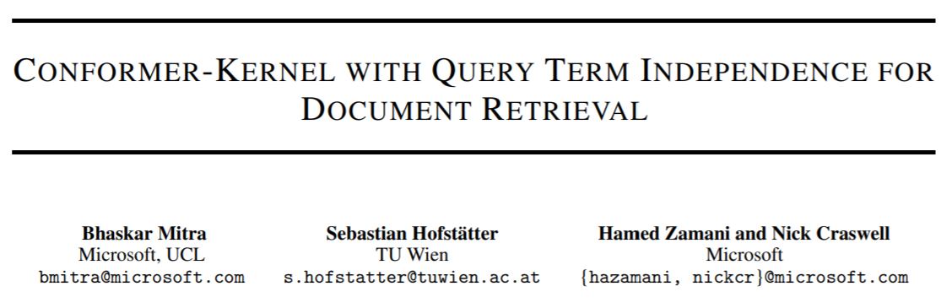
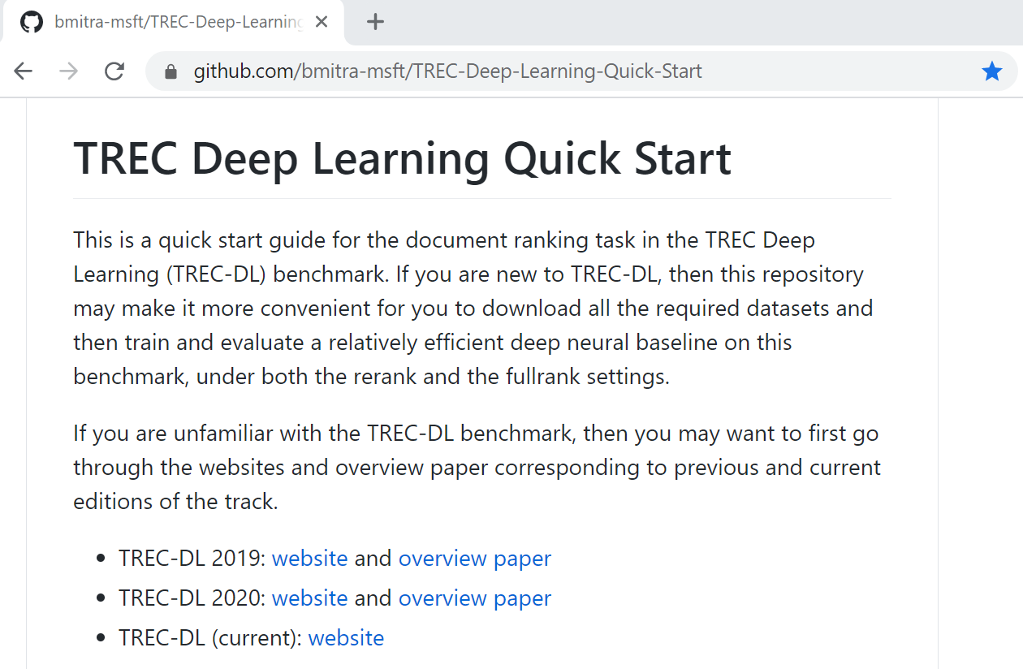
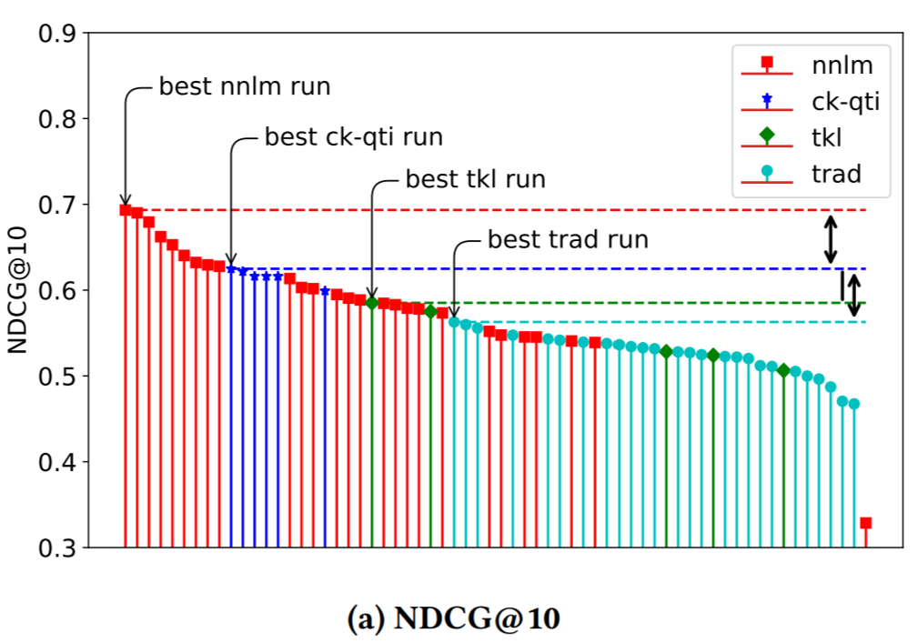
Reusable research artifacts: Code
Relatively cheap to reproduce neural baseline that outperformed all trad + nn runs and two-thirds of all nnlm runs at TREC 2020 Deep Learning Track
https://github.com/bmitra-msft/TREC-Deep-Learning-Quick-Start

Slide 28



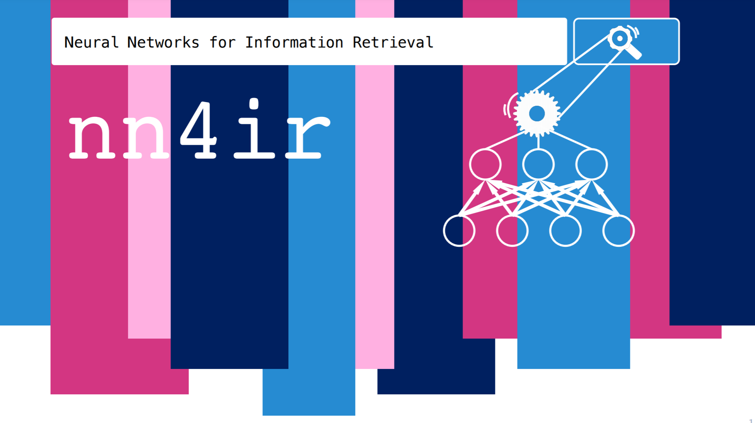
Learning resources
(slides, video)
(slides)
(website)
http://bit.ly/fntir-neural

Slide 29
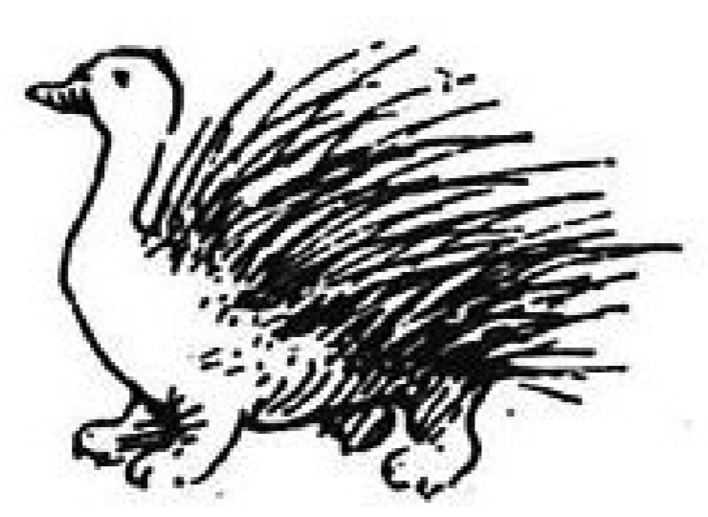
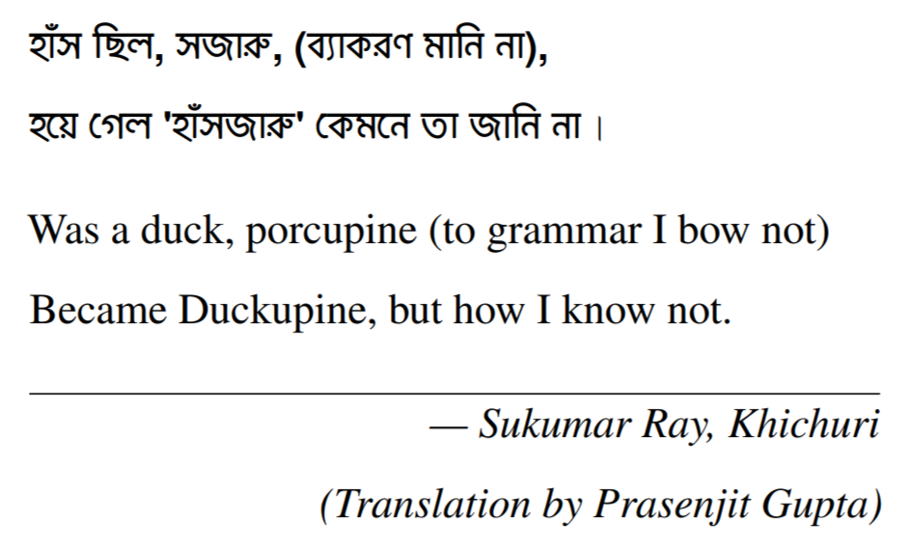
Thank you!
@UnderdogGeek
bmitra@microsoft.com

